Slide 1
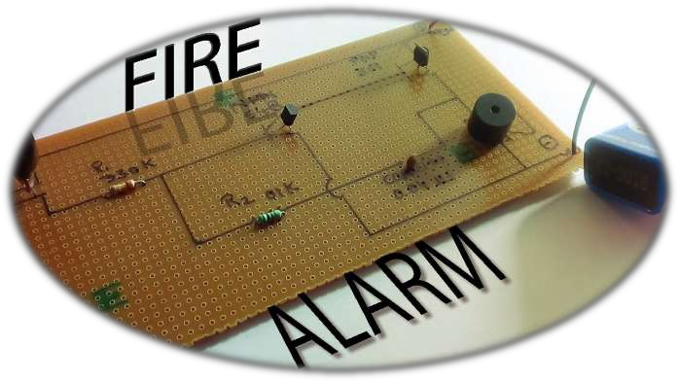
PHYSICS PROJECT
FIRE ALARM
SUBMITTED BY:
AMIT YADAV
UID- 18BCS6022
YASH AGRAWAL
UID- 18BCS6023
MOHIT
UID- 18BCS6024
NITIN
UID- 18BCS6025
HARSHVARDHAN
UID-18BCS6026
ANANYA
UID- 18BCS6027
PRATEEK
SUBMITTED TO :
PRIYANKA MA’AM

Slide 2
INTRODUCTION
An automatic fire alarm system is designed to detect the unwanted presence of fire by monitoring environmental changes associated with combustion. In general, a fire alarm system is either classified as automatic, manually activated, or both. Automatic fire alarm systems can be used to notify people to evacuate in the event of a fire or other emergency, to summon emergency services, and to prepare the structure and associated systems to control the spread of fire and smoke. Fire alarm systems have become increasingly sophisticated and functionally more capable and reliable in recent years. They are designed to fulfill two general requirements: protection of property and assets and protection of life. As a result of state and local codes, the life-safety aspect of fire protection has become a major factor in the last two decades. There are a number of reasons for the substantial increases in the life-safety form of fire protection during recent years, foremost of which are
The proliferation of high-rise construction and the concern for life safety within these buildings.
A growing awareness of the life-safety hazard in residential, institutional, and educational occupancies.
Increased hazards caused by new building materials and furnishings that create large amounts of toxic combustion products (i.e., plastics, synthetic fabrics, etc.).
Vast improvements in smoke detection and related technology made possible through quantum advances in electronic technology.
The passing of the Americans with Disabilities Act (ADA), signed into law on July 26, 1990, providing comprehensive civil rights protection for individuals with disabilities. With an effective date of January 26, 1992, these requirements included detailed accessibility standards for both new construction and Renovation towards the goal of equal usability of buildings for everyone, regardless of limitations of sight, hearing, and mobility. This had a significant impact on fire alarm system signaling devices, power requirements, and device locations.

Slide 3
THEORY
A fire alarm system has a number of devices working together to detect and warn people through visual and audio appliances when smoke, fire, carbon monoxide or other emergencies are present. These alarms may be activated automatically from smoke detectors and heat detectors or may also be activated via manual fire alarm activation devices such as manual call points or pull stations. Alarms can be either motorized bells or wall mountable sounders or horns. They can also be speaker strobes which sound an alarm, followed by a voice evacuation message which warns people inside the building not to use the elevators. Fire alarm sounders can be set to certain frequencies and different tones including low, medium and high, depending on the country and manufacturer of the device.
WE WILL BE STUDYING A THERMISTOR BASED FIRE ALARM WHERE WE WILL USE FIRE SWITCH TO CONTROL THE CIRCUIT.

Slide 4

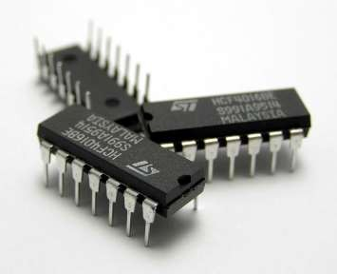
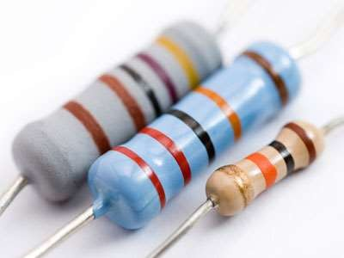

COMPONENTS OF FIRE ALARM CIRCUIT
Battery
PCB Board
Fire switch
Resistance 330K
Resistance 01K
Capacitor 0.04µF
Buzzer
Connecting wires
Solder

Slide 5
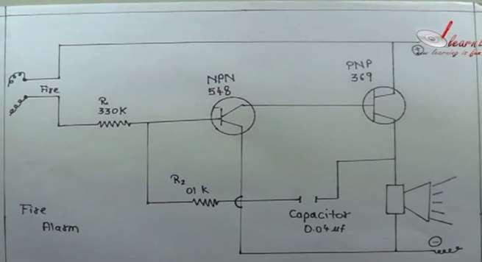
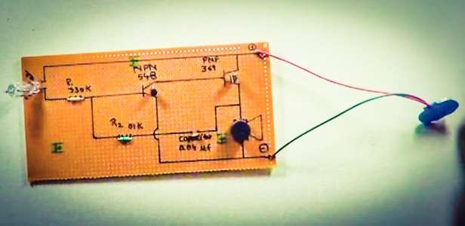
CIRCUIT DIAGRAM

Slide 6
CIRCUIT WORKING
[
All the components are soldered using soldering wire and are fixed on PCB board.
Resistors of 330k and 0.1k are used to bias transistors so that they work according to our requirement in the circuit and control the flow of current I the desired way.
We have npn and pnp transistors to control the flow of current.
Capacitors store the energy and let the alarm sound for some time after the fire switch turns off.
We have a buzzer that will sound as soon as a fire is detected by the fire switch.
The main component of the whole circuit is the fire switch that is responsible for its working.
FIRE SWITCH
It’s a device that works on the stimulus of temperature.
It consists of a bimetallic strips that are initially separated when there is no fire that is the temperature is normal room temperature. As soon as there is a fire the temperature goes up and the strips comes closer to touch each other and complete the circuit. This lead the current to flow in the circuit and the buzzer sounds

Slide 7
OBSERVATIONS
We have seen that initially there was no buzzer sound as none of the fire was detected.
When we bring a match stick near the fire switch with a time lag of 5-10 seconds the buzzer starts giving sound as the fire is detected and the circuit is completed by the action of bimetallic strip.
When we remove the burning match stick away from switch, the buzzer continues to give the sound for some time due to action of capacitor and time is required by switch to return to room temperature.

Slide 8
CONCLUSION
A fire alarm is a device that detects the presence of fire and atmospheric changes relating to smoke. In some cases, a firm alarm
is a part of a complete security system, in addition to a burglary protection system. The fire alarm operates to alert people to evacuate a location in which a fire or smoke accumulation is present. When functioning properly, a fire alarm will sound to notify people of an immediate fire emergency. Fire alarms can be found in homes, schools, churches and businesses, and function as the catalyst to saving lives. For most fire alarms, when sounded, a beep, bell or horn noise is made. This distinct sound exists to allow the notification to be heard. The fire alarm constructed by this project work is reliable at low cost.

Slide 9




PRECAUTIONS
Components of the circuit should be handled carefully.
Care should be taken while soldering as it may burn the skin.
Connecting wires should be insulated to prevent disturbance.
Connections should be tight as it may break easily.
Soldering must be done carefully as it may burn the PCB board.

